Slide 1


Predictive Modeling for Hotel Booking Cancellations
Analyzing and Forecasting Guest Cancellation Behavior
Author: Ali El Masri
Date: 07/21/2024
Notes:
"Welcome to our presentation on Predictive Modeling for Hotel Booking Cancellations. In this session, we will explore the analysis and forecasting of guest cancellation behavior. My name is Ali so Let's dive into the details."

Slide 2

Introduction
Problem Statement:
Booking cancellations lead to lost revenue and resource inefficiencies.
Objective:
To develop predictive models to forecast cancellations.
Benefits:
Enhances operational efficiency, revenue management, and customer satisfaction.
Notes:
"Booking cancellations present significant challenges to the hospitality industry, leading to lost revenue and resource inefficiencies. The objective in this study is to develop predictive models to forecast these cancellations. By doing so, we aim to enhance operational efficiency, improve revenue management, and boost customer satisfaction."

Slide 3
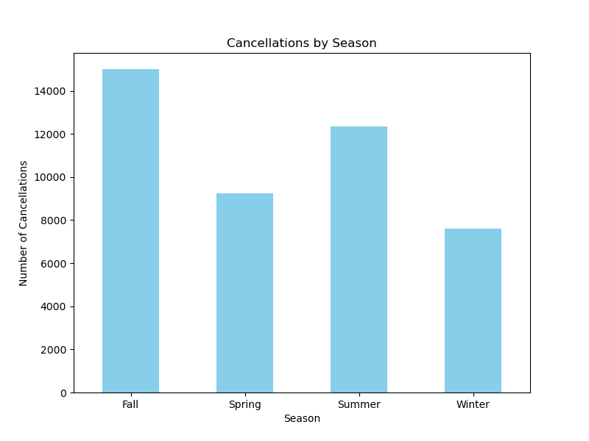
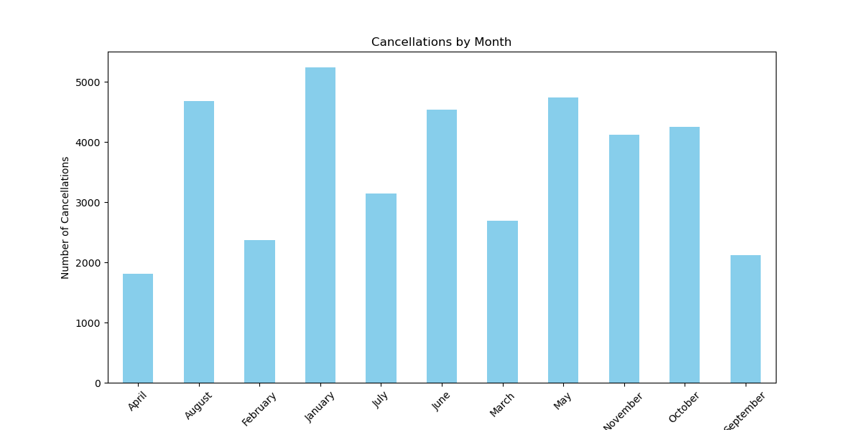
Exploratory Data Analysis (EDA)
Findings:
High correlation between lead time and cancellations.
Differences in cancellation behavior by market segment and deposit type.
Seasonal trends in cancellations.
Notes:
“Just like any other project we start by exploratory data analysis. Our basic EDA revealed several important patterns. We found a high correlation between lead time and cancellation rates. Cancellation behavior varied significantly across different market segments and deposit types, and we identified seasonal trends with higher cancellation rates during specific months.

Slide 4

Data Preprocessing
119,390 entries with 32 features.
Handling missing values.
Encoding categorical variables.
Feature selection and engineering.
Normalization.
Notes:
The dataset, obtained from Kaggle, includes 119,390 entries with 32 features pertaining to hotel bookings. Our preprocessing steps involved handling missing values, encoding categorical variables into numerical values, followed by one-hot encoding, and scaling numerical data to have a mean of 0 and a standard deviation of 1. These steps were essential for preparing the data for effective modeling and significantly influenced the model's performance. Furthermore, the data was split into 60% for training, 20% for validation, 10% for testing, and 10% for incremental learning to allow for model retraining. For cross-validation, an 80% split was used for training and validation, with the remaining 20% held out for testing.

Slide 5
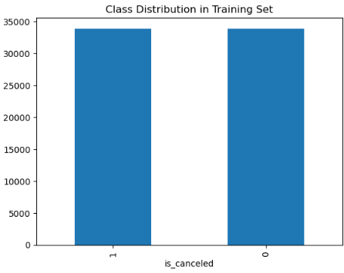
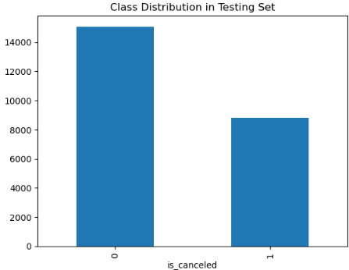
Handling Class Imbalance
Issue: Imbalanced dataset with more non-canceled bookings.
Solution: Applied SMOTE (Synthetic Minority Over-sampling Technique).
Comparison: SMOTE vs. weighted class approach.
Notes:
"One major challenge was the imbalance in our dataset, with a significantly higher number of non-canceled bookings. To address this, we applied the Synthetic Minority Over-sampling Technique, or SMOTE, which generates synthetic samples for the minority class. We also experimented with weighting the classes, but the SMOTE approach proved more effective in balancing our dataset. Now, in the top left figure, we can observe the balanced distribution between class 0 and class 1, representing non-canceled and canceled bookings, after applying SMOTE for our training set. However, for the testing set, we preserved the imbalance to maintain its true distribution."

Slide 6
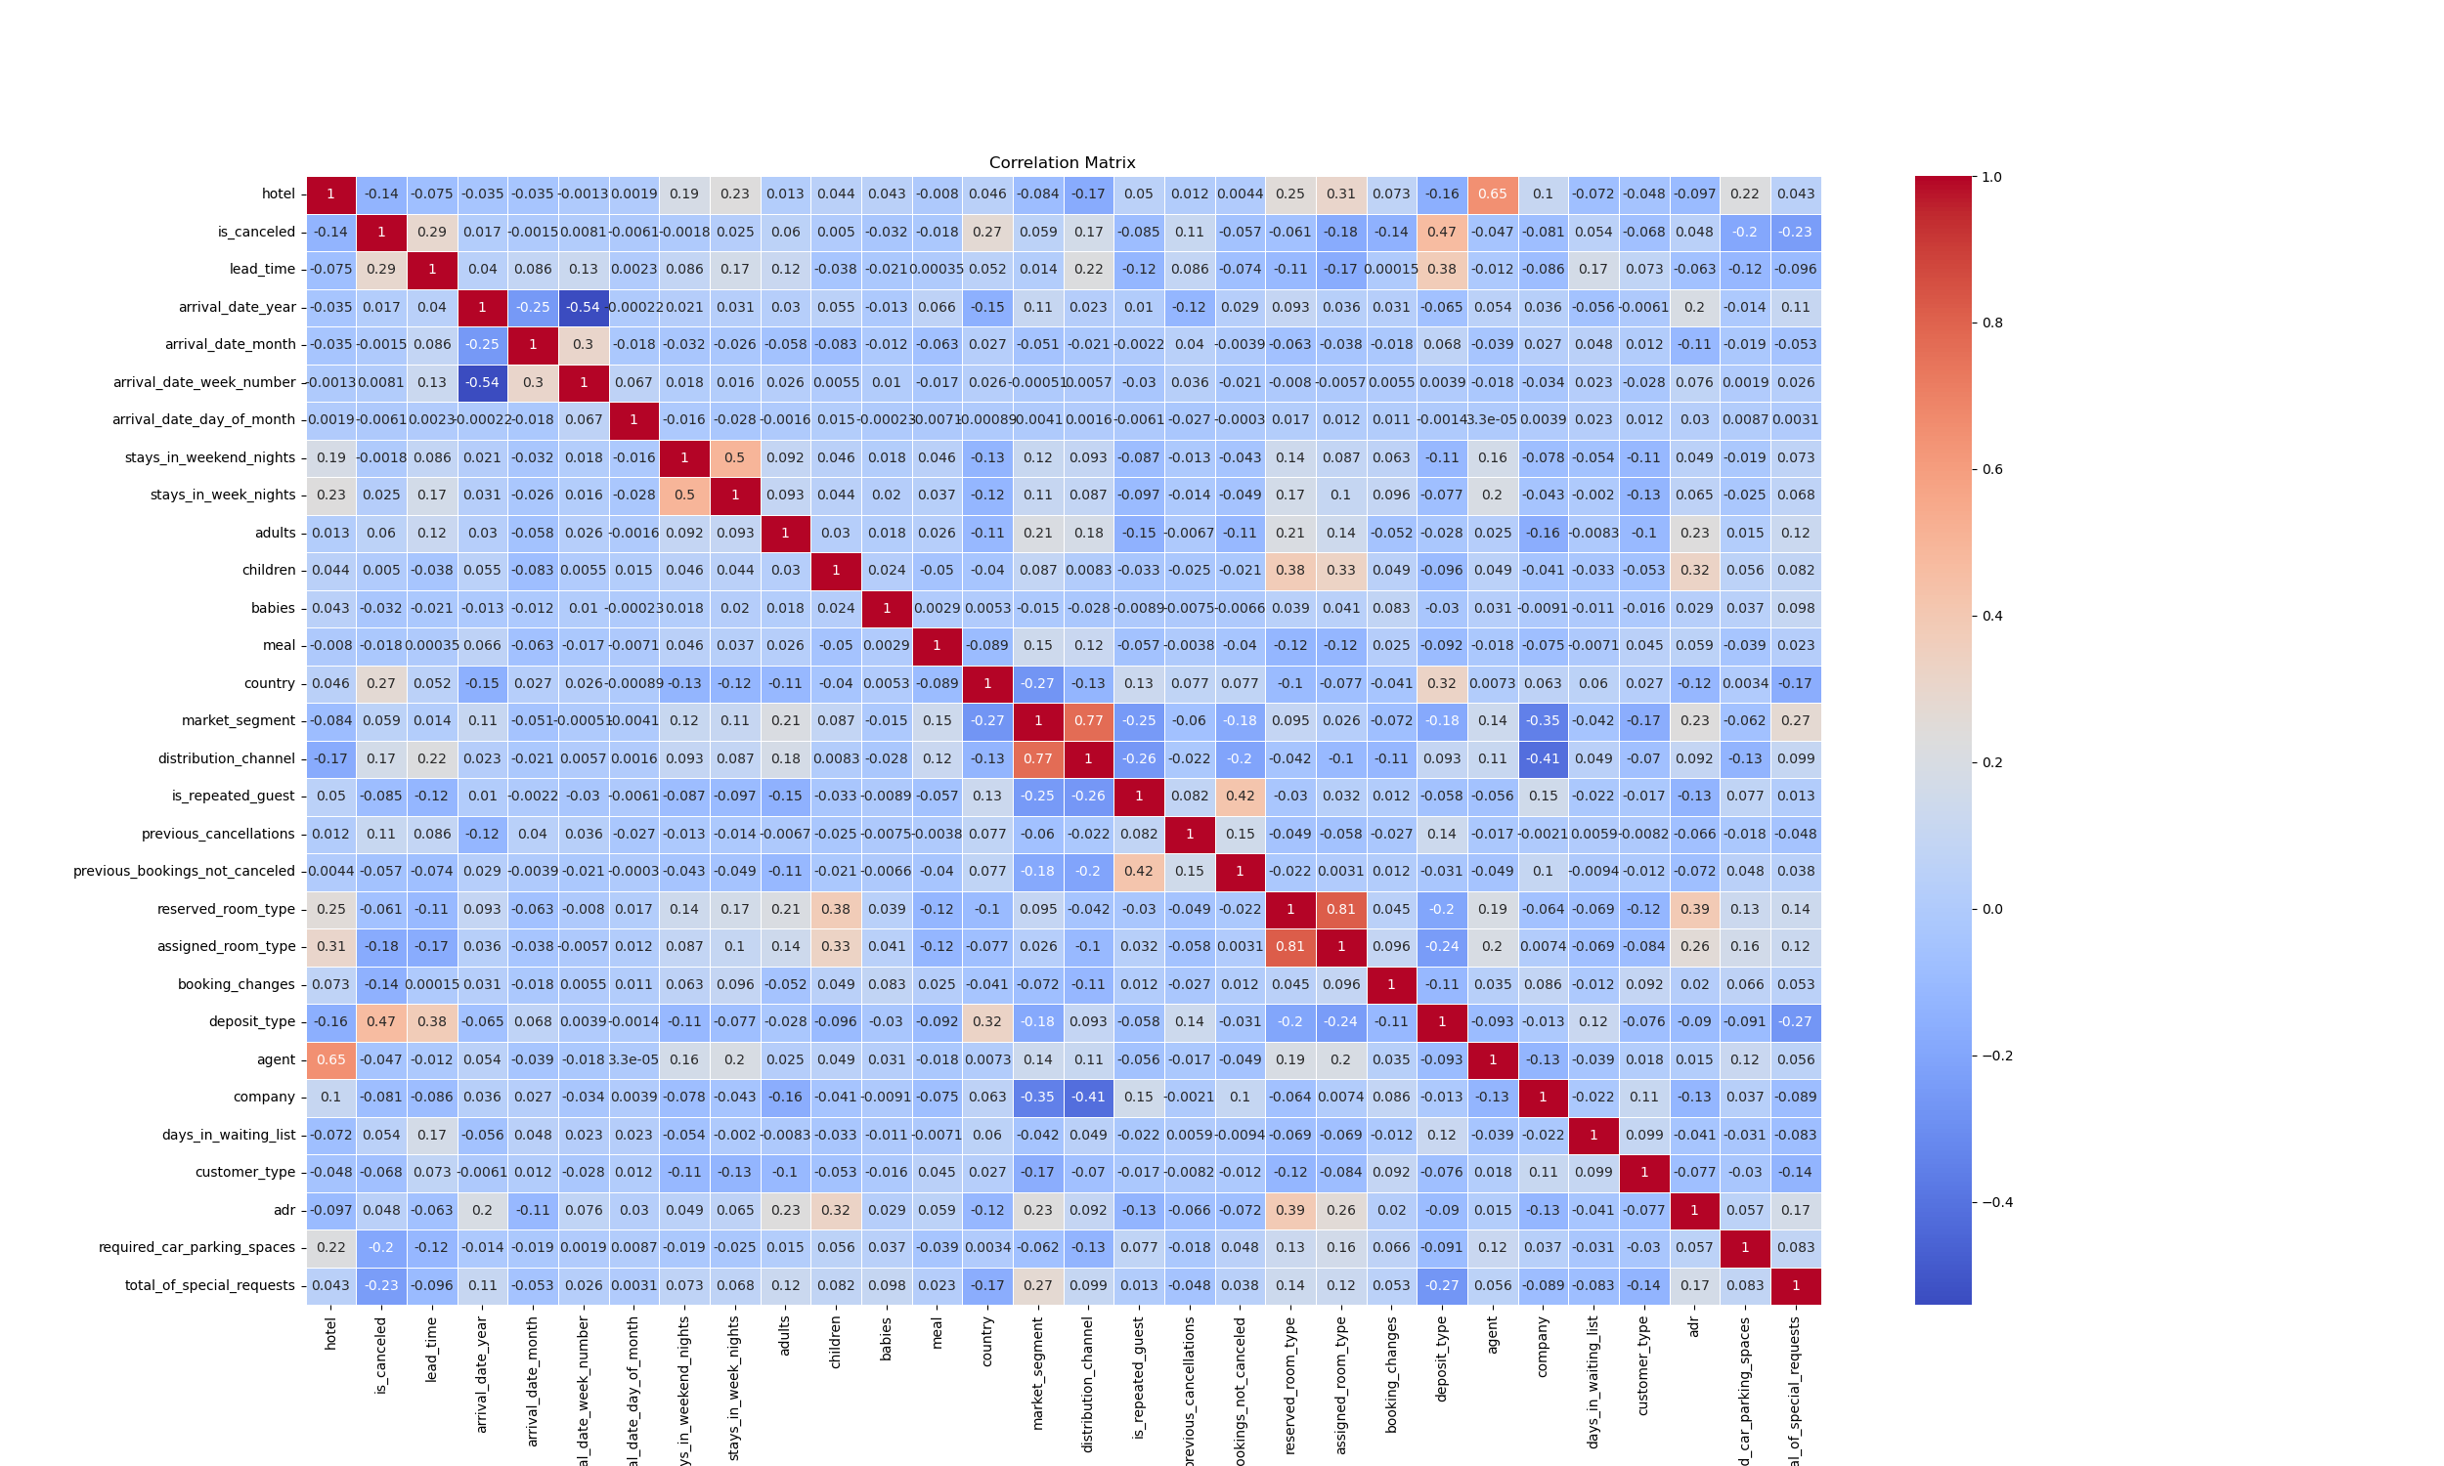
Correlation Matrix
Notes:
"Our correlation matrix analysis revealed some critical insights into the relationship between various features and cancellation rates. One of the highly correlated variables were dropped, such as distribution chanel in relation to market segment and reserved room type in relation to assigned room type. One of the most significant findings is the high correlation between lead time and cancellations, indicating that longer lead times generally lead to higher cancellation rates. Additionally, we observed important patterns in the correlations between market segments, deposit types, and cancellations. These insights are crucial as they guide the feature selection process and model development. Please refer to the matrix in Figure 1 for a detailed visual representation of these correlations."

Slide 7
Model Development
Models Tested:
- Logistic Regression
- Random Forest
- Neural Network
- Decision Tree
- Support Vector Machine (SVM)
- K-Nearest Neighbors (KNN)
- Gradient Boosting Machine (GBM)
Metrics: Accuracy, Precision, Recall, F1 Score
Model | Accuracy | Precision | Recall | F1 Score
Neural Network | 0.883 | 0.8385 | 0.8474 | 0.8429
Random Forest | 0.8841 | 0.8575 | 0.8224 | 0.8396
Weighted Neural Network | 0.872 | 0.8098 | 0.8553 | 0.8319
Rule Based Model | 0.7495 | 0.9852 | 0.3286 | 0.4928
Logistic Regression | 0.8329 | 0.7473 | 0.8265 | 0.7849
Decision Tree | 0.8626 | 0.81 | 0.82 | 0.81
SVM | 0.8675 | 0.7962 | 0.8612 | 0.8274
KNN | 0.7854 | 0.6613 | 0.8572 | 0.7466
GBM | 0.8529 | 0.7945 | 0.8108 | 0.8026
Notes:
"We tested a variety of machine learning models, including Logistic Regression, Random Forest, Neural Network, Decision Tree, Support Vector Machine, K-Nearest Neighbors, and Gradient Boosting Machine. We also included a simple rule based model that predicts cancelation based on the type of deposit since the deposit type was identified as the most important feature by our decision tree. Each model was evaluated based on metrics such as accuracy, precision, recall, and F1 score. The table on this slide summarizes the performance metrics for each model.

Slide 8
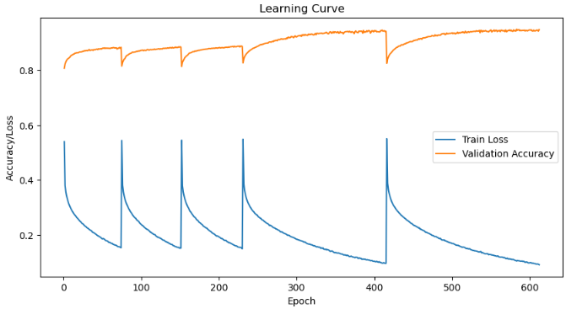
Hyperparameter Tuning
Best Parameters:
Decision Tree:'criterion': 'entropy’, 'max_depth': 20, 'min_samples_leaf': 2, 'min_samples_split': 10
Random Forest: 'max_depth': 30, 'min_samples_leaf': 1, 'min_samples_split': 2, 'n_estimators': 200
Neural Network: Drop Rate: 0.3, Learning Rate: 0.001, Batch Size: 64
Notes:
"To optimize model performance, we performed hyperparameter tuning. For the Decision Tree, we used criteria such as entropy, a max depth of 20, and a minimum samples split of 10. The Random Forest was tuned with a max depth of 30 and 200 estimators. Our Neural Network model used a dropout rate of 0.3, a learning rate of 0.001, and a batch size of 64.
Let's look at the training process of the Neural Network model as shown in this figure. The accuracy graph illustrates a steady improvement in validation accuracy over the epochs, stabilizing around 0.94. The occasional drops in accuracy are due to cyclic learning rates, which help the model escape local minima for better convergence.
Similarly, the loss graph shows a consistent decrease in training loss, indicating that the model is refining its predictions. The periodic spikes in loss, followed by rapid decreases, correspond to adjustments in the learning rate, supporting the model’s path to an optimal solution.

Slide 9
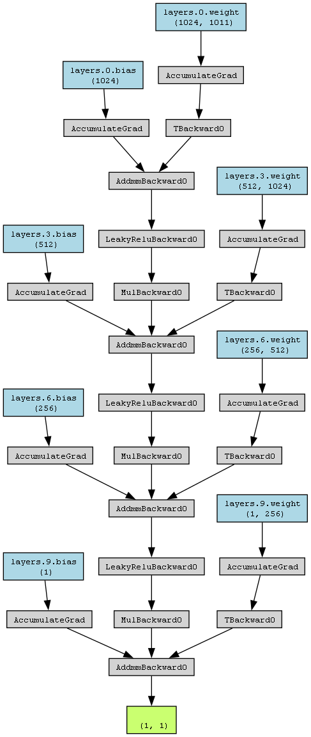
Neural Network Architecture
Input Layer:
Role: Represents the input features of the data.
Details: 1011 features.
First Linear Layer:
Role: Performs linear transformation on input data.
Details: 1024 output features.
First Leaky ReLU Activation:
Role: Introduces non-linearity.
Details: Negative slope of 0.01.
First Dropout Layer:
Role: Prevents overfitting.
Details: Dropout probability of 0.3.
Second Linear Layer:
Role: Further linear transformation.
Details: 512 output features.
Second Leaky ReLU Activation:
Role: Introduces additional non-linearity.
Details: Same as first.
Second Dropout Layer:
Role: Continues to prevent overfitting.
Details: Dropout probability of 0.3.
Third Linear Layer:
Role: Further linear transformation.
Details: 256 output features.
Third Leaky ReLU Activation:
Role: Introduces more non-linearity.
Details: Same as previous.
Third Dropout Layer:
Role: Continues to prevent overfitting.
Details: Dropout probability of 0.3.
Output Linear Layer:
Role: Final linear transformation.
Details: 1 output feature.
Notes:
Our neural network architecture begins with an input layer representing 1011 features. The first linear layer performs a transformation to produce 1024 features. This is followed by a Leaky ReLU activation introducing non-linearity, and a dropout layer with a probability of 0.3 to prevent overfitting. The second linear layer reduces features to 512, followed by another Leaky ReLU activation and dropout layer. The third linear layer further reduces features to 256, again followed by Leaky ReLU activation and dropout. The final output layer produces a single output feature that passes through a sigmoid function for binary classification. Each layer plays a crucial role in transforming the input data, introducing non-linearity, and preventing overfitting, leading to a model that generalizes well to unseen data.

Slide 10
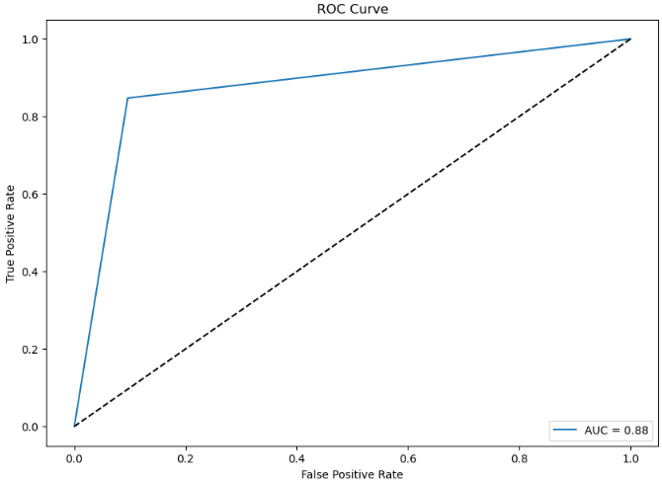
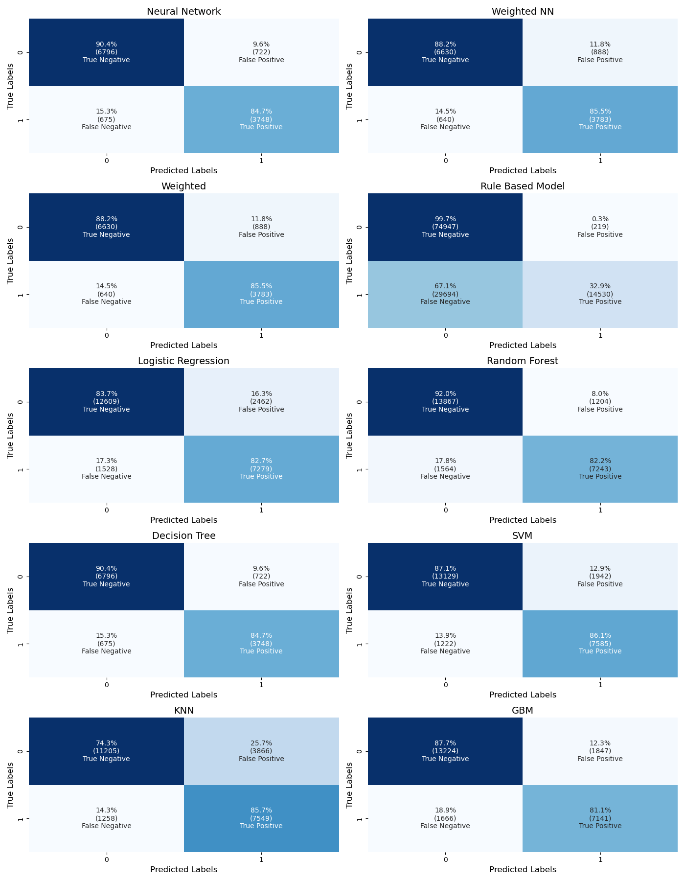
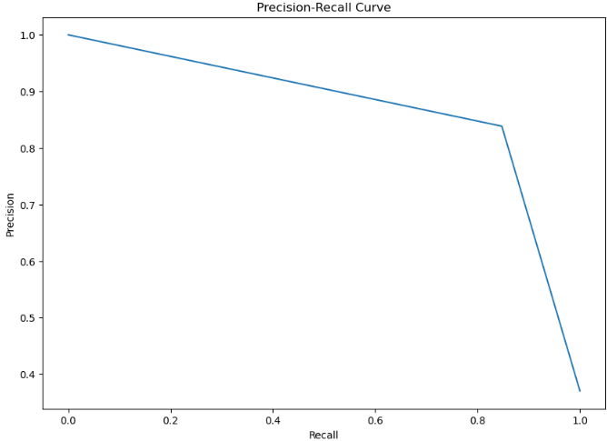
Model Performance & Evaluation Metrics:
ROC Curve
Precision-Recall Curve
Confusion Matrix
Notes:
"Our model performance evaluation involves several key metrics, including ROC curves, precision-recall curves, and confusion matrices. The confusion matrices shown here provide a detailed breakdown of the true positives, true negatives, false positives, and false negatives for each model we tested.
Starting with the Neural Network model, we see a high true negative rate of 90.4% and a true positive rate of 84.7%, indicating strong performance in correctly predicting both cancellations and non-cancellations. This model also has a relatively low false positive rate of 9.6%, meaning it rarely predicts cancellations when there aren't any.
The Weighted Neural Network model also performs well, with a true negative rate of 88.2% and a true positive rate of 85.5%. However, it shows a slightly higher false positive rate of 11.8%.
Our Rule-Based model, while having an exceptionally high true negative rate of 99.7%, struggles with false positives, as shown by a significantly lower true positive rate of 32.9%. This indicates it is very conservative in predicting cancellations.
Logistic Regression, Random Forest, Decision Tree, SVM, KNN, and GBM models all show varying levels of performance, with Random Forest achieving the highest true negative rate of 92.0% but a moderate true positive rate of 82.2%.
Overall, the Neural Network and Weighted Neural Network models offer the best balance between true positive and true negative rates, making them the most effective for predicting hotel booking cancellations with minimal errors.
These confusion matrices highlight the strengths and weaknesses of each model, providing us with valuable insights into their predictive capabilities. By understanding these details, we can make informed decisions on which model to deploy for real-world applications."

Slide 11
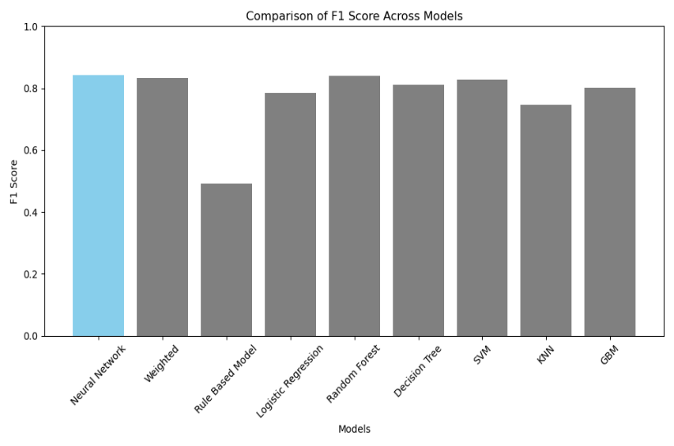
Conclusion
Summary:
- Neural network model showed the best performance.
- Predictive modeling can significantly reduce booking cancellations.
Future Work:
- Further tuning of models.
- Incorporating cyclical feature encoding.
- Experimenting with incremental learning techniques.
Notes:
"In conclusion, our study shows that predictive modeling can significantly reduce booking cancellations in the hospitality industry. The Neural Network model, in particular, provided the best balance between precision and recall. Future work will focus on further tuning of the model, incorporating cyclical feature encoding, and experimenting with incremental learning techniques to enhance predictive capabilities."

